Slide 1
Petri Nets + Decision Tables

Slide 2
Petri Nets
A form or state-transition notation that is used to model concurrent activities and their interaction
Circles (places) represent activities or conditions
Bars represents transitions
Arcs connect a transition with its input places and its output places
The places are populated with tokens, which act as enabling conditions for the transitions
Each arc can be assigned a weight that specifies how many tokens are removed from arc's input place, when the transition fires
Notes:
A Petri Net is a collection of directed arcs connecting places and transitions. Places may hold tokens. The state or marking of a net is its assignment of tokens to places.

Slide 3
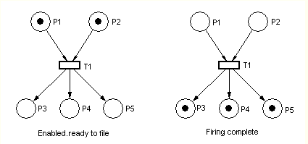
Petri Nets

Slide 4
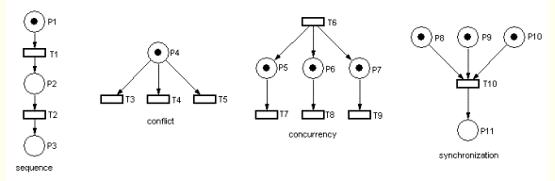
Petri Nets

Slide 5
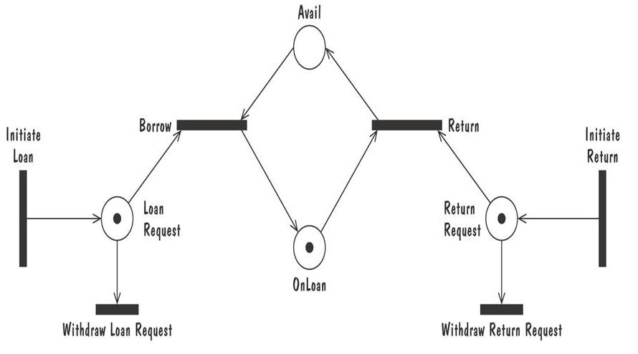
Petri Nets
Petri net of book loan

Slide 6
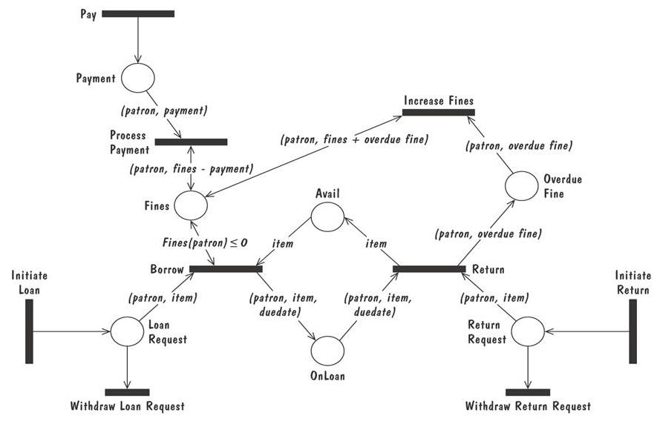
Petri Nets
A high level Petri net specification for the library problem

Slide 7
Decision Tables
It is a tabular representation of a functional specification that maps events and conditions to appropriate responses or action
The specification is formal because the inputs (events and conditions) and outputs (actions) may be expressed in natural language
Combinations map to the same set of result can be combined into a single column

Slide 8
Developing Decision Tables – Steps 1 and 2
Determine the number of conditions that may affect the decision.
Combine rows that overlap, for example, conditions that are mutually exclusive e.g. gender, education etc.
The number of conditions becomes the number of rows in the top half of the decision table.
Determine the number of possible actions that can be taken.
This becomes the number of rows in the lower half of the decision table.
Notes:
Mutually exclusive conditions should be combined to be one condition with multiple alternatives

Slide 9
Developing Decision Tables – Steps 3 and 4
Determine the number of condition alternatives for each condition.
In the simplest form of decision table, there would be two alternatives (Y or N) for each condition.
Calculate the maximum number of columns in the decision table by multiplying the number of alternatives for each condition. •
If there are four conditions and two alternatives for each of them, there will be 2*2*2*2 = 16 possibilities

Slide 10
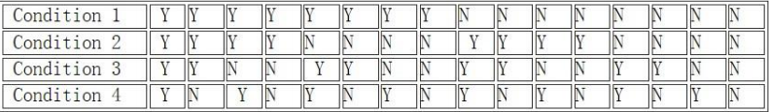
Developing Decision Tables – Step 5
Fill in the condition alternatives. Start with the first condition and divide the number of columns by the number of alternatives for that condition.

Slide 11
Developing Decision Tables – Steps 6 – 9
Complete the table by inserting an X where rules suggest certain actions.
Combine rules where it is apparent that an alternative does not make a difference in the outcome
Check the table for any impossible situations, contradictions, redundancies.
Rearrange the conditions and actions (or even rules) to make the decision table more understandable.

Slide 12
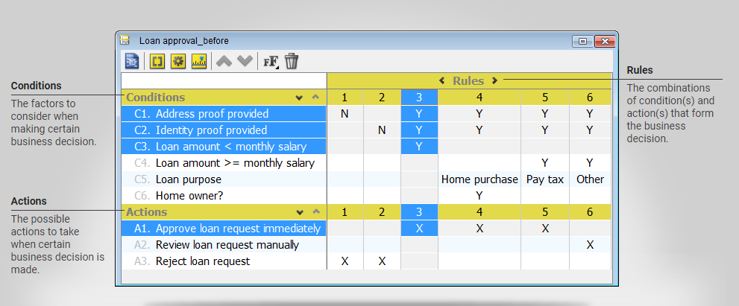
Decision Tables (Contd.)

Slide 13
Example
When a burglar alarm sounds, if it is in one of students’ houses where alarm sounds every week, ignore it. Otherwise have a look outside and if the house looks not broken into and there is nobody moving inside it, ignore the alarm. Otherwise call police.

Slide 14
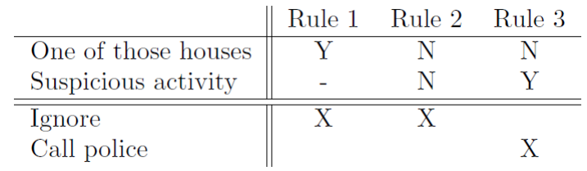
Possible Solution

Slide 15
Decision Tables (Contd.)
What is the discount for a frequent flyer who want to make an early reservation?
Infant passengers under two years old are offered a discount of 80% on domestic flights. Infant passengers under two years old are offered a discount of 70% on international flights. Youth passengers (between two and sixteen) are offered a discount of 10%, for any kind of destination. Passengers who make reservation five months before their journey are offered a discount of 10%. For international flights, passengers are offered 15% discount if they travel during off-seasons. There would be no discount for international flights, except that when the passenger is an infant passenger or when travelling during off-season. Frequent flyer enjoys a discount of 15%. The amount of discount is accumulated. The maximum amount of discount for infant passengers is 80% The maximum amount of discount for non-infant passengers is 20%.

Slide 16
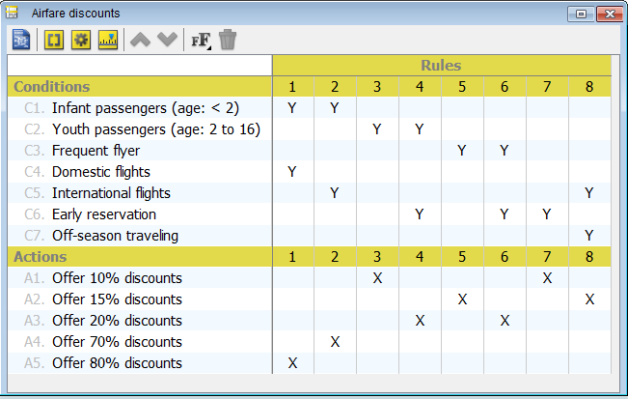
Decision Tables (Contd.)

Slide 17
Prototyping Requirements
To elicit the details of proposed system
To solicit feedback from potential users about
what aspects they would like to see/improve
which features are not so useful
what functionality is missing
Determine whether the customer's problem has a feasible solution
Assist in exploring options for optimizing quality requirements

Slide 18
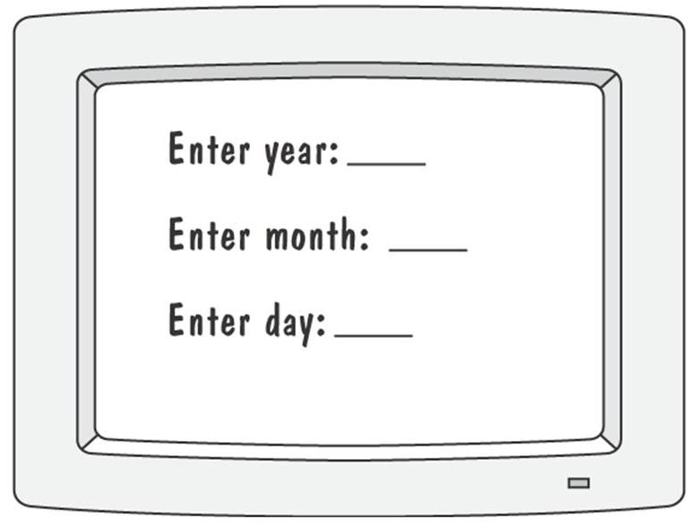
Prototyping Example
Prototype for building a tool to track how much a user exercises each day
Graphical respresentation of first prototype, in which the user must type the day, month and year

Slide 19
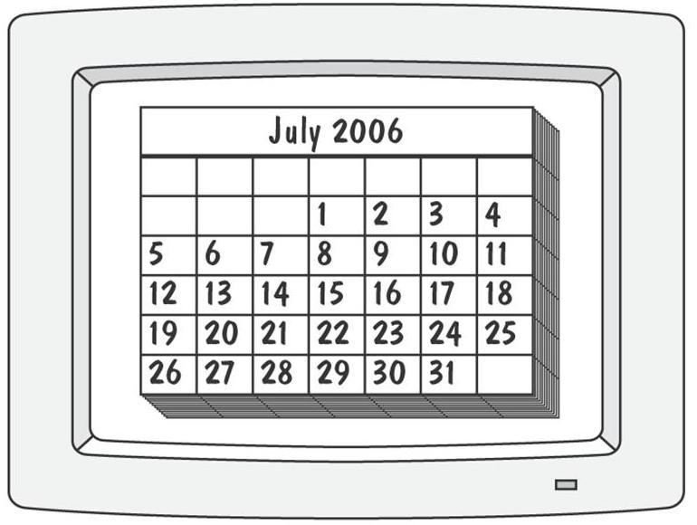
Prototyping Requirements
Second prototype shows a more interesting and sophisticated interface involving a calendar
User uses a mouse to select the month and year
The system displays the chart for that month, and the user selects the appropriate date in the chart

Slide 20
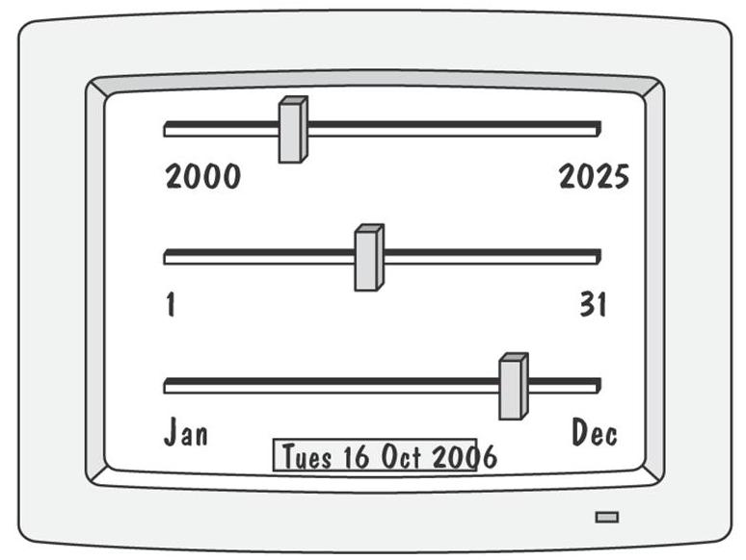
Prototyping Requirements
Third prototype shows that instead of calendar, the user is presented with three slide bars
User uses the mouse to slide each bar left or right
The box at the bottom of the screen changes to show the selected day, month, and year

Slide 21
Approaches to Prototyping
Throwaway approach
Developed to learn more about a problem or a proposed solution, and that is never intended to be part of the delivered software
Allow us to write “quick-and-dirty”
Evolutionary approach
Developed not only to help us answer questions but also to be incorporated into the final product
Prototype has to eventually exhibit the quality requirements of the final product, and these qualities cannot be retrofitted
Both techniques are sometimes called rapid prototyping

Slide 22
Prototyping vs Modelling
Prototyping
Good for answering questions about the user interfaces
Modelling
Quickly answer questions about constraints on the order in which events should occur, or about the synchronization of activities

Slide 23
DOCUMENTING REQUIREMENTS
UCF Slides

Slide 24
Requirements Documentation Requirement Definition: Steps Documenting Process
Outline the general purpose and scope of the system, including relevant benefits, objectives, and goals
Describe the background and the rationale behind proposal for new system
Describe the essential characteristics of an acceptable solution
Describe the environment in which the system will operate
Outline a description of the proposal, if the customer has a proposal for solving the problem
List any assumptions we make about how the environment behaves

Slide 25
Requirements Documentation Requirement Specification: Steps Documenting Process
Describe all inputs and outputs in detail, including
the sources of inputs
the destinations of outputs,
the value ranges
data format of inputs and output data
data protocols
window formats and organizations
timing constraint
Restate the required functionality in terms of the interfaces' inputs and outputs
Devise fit criteria for each of the customer's quality requirements

Slide 26
Requirements Documentation IEEE Standard for SRS Organized by Object
Introduction to the Document
1.1 Purpose of the Product
1.2 Scope of the Product
1.3 Acronyms, Abbreviations, Definitions
1.4 References
1.5 Outline of the rest of the SRS
General Description of Product
2.1 Context of Product
2.2 Product Functions
2.3 User Characteristics
2.4 Constraints
2.5 Assumptions and Dependencies
Specific Requirements
3.1 External Interface Requirements
3.1.1 User Interfaces
3.1.2 Hardware Interfaces
3.1.3 Software Interfaces
3.1.4 Communications Interfaces
3.2 Functional Requirements
3.2.1 Class 1
3.2.2 Class 2
…
3.3 Performance Requirements
3.4 Design Constraints
3.5 Quality Requirements
3.6 Other Requirements
Appendices

Slide 27
Requirements Documentation Process Management and Requirements Traceability
Process management is a set of procedures that track
the requirements that define what the system should do
the design modules that are generated from the requirement
the program code that implements the design
the tests that verify the functionality of the system
the documents that describe the system
It provides the threads that tie the system parts together

Slide 28
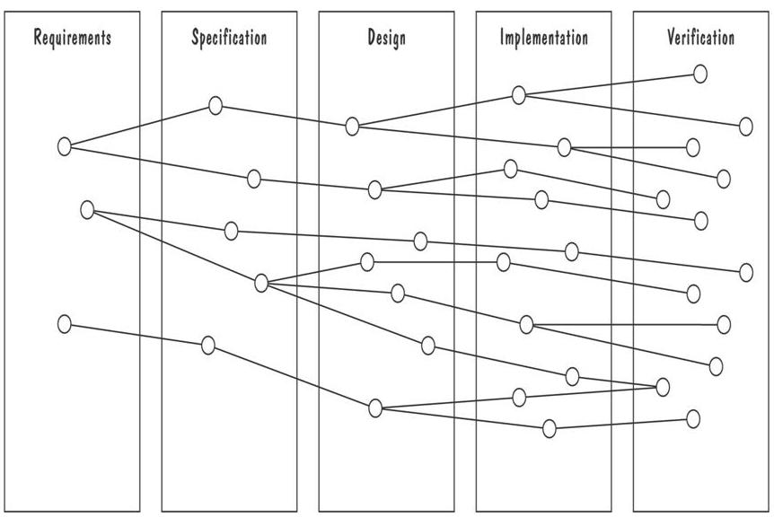
Requirements Documentation Development Activities and Traceability
Horizontal threads show the coordination between development activities

Slide 29
Validation and Verification
In requirements validation, we check that our requirements definition accurately reflects the customer's needs
In verification, we check that one document or artefact conforms to another
Verification ensures that we build the system right, whereas validation ensures that we build the right system

Slide 30
Validation and Verification Requirements Review
Review the stated goals and objectives of the system
Compare the requirements with the goals and objectives
Review the environment in which the system is to operate
Review the information flow and proposed functions
Assess and document the risk, discuss and compare alternatives
Testing the system: how the requirements will be revalidated as the requirements grow and change

Slide 31
Validation and Verification Verification
Check that the requirements-specification document corresponds to the requirements-definition
Make sure that if we implement a system that meets the specification, then the system will satisfy the customer's requirements
Ensure that each requirement in the definition document is traceable to the specification

Slide 32
Measuring Requirements
Measurements focus on three areas
product
process
resources
Number of requirements can give us a sense of the size of the developed system
Number of changes to requirements
Many changes indicate some instability or uncertainty in our understanding of the system
Requirement-size and change measurements should be recorded by requirements type

Slide 33
Measuring Requirements Rating Scheme on Scale from 1 to 5
You understand this requirement completely, have designed systems from similar requirements, and have no trouble developing a design from this requirement
Some elements of this requirement are new, but they are not radically different from requirements that have been successfully designed in the past
Some elements of this requirement are very different from requirements in the past, but you understand the requirement and can develop a good design from it
You cannot understand some parts of this requirement, and are not sure that you can develop a good design
You do not understand this requirement at all, and can not develop a design

Slide 34
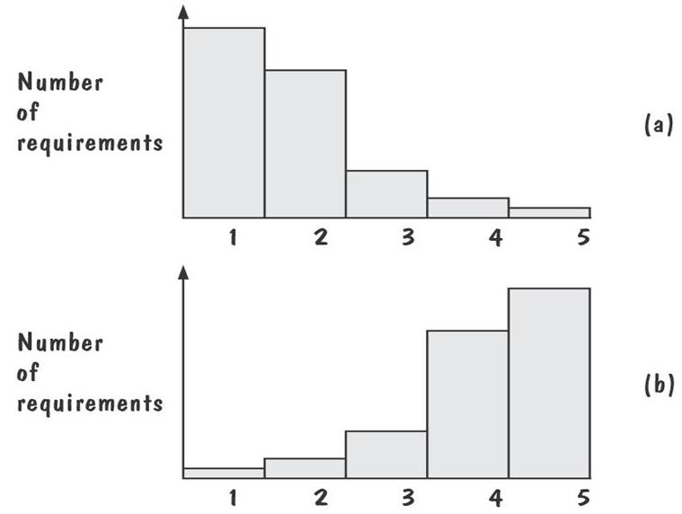
Measuring Requirements: Testers/Designers Profiles
Figure (a) shows profiles with mostly 1s and 2s
The requirements are in good shape
Figure (b) shows profiles with mostly 4s and 5s
The requirements should be revised

Slide 35
References
Pfleeger Book slides from UCF
Acknowledgement!
A few slides have been reused from UCF slides for the SE course

